Slide 1

CredPulse
AI-Powered Credit Risk Intelligence Platform
NeoStats — AI Engineer Candidate Assignment
Prepared by Abhishek • github.com/Abhishek84094/AI-Powered-Credit-Risk-Intelligence-Platform
Live: ai-powered-credit-risk-intelligence.onrender.com
Home Credit Default Risk Dataset
307K+ Applicants
6-Layer Architecture

Slide 2




BUSINESS CONTEXT
Faster, Explainable Credit Decisions
Banks must identify high-risk applicants early, automate scoring, and justify every decision to regulators and applicants alike. CredPulse combines a calibrated ML risk model, exact Shapley-value explanations, and a natural-language analytics layer into one deployable platform.
SUBMISSION SCOPE
Exploratory Data Analysis
ML Risk Scoring Model
Automated Risk Scoring
Calibrated default-probability model with LOW / MEDIUM / HIGH risk bands.
Explainable AI (TreeSHAP)
Talk-to-Data (NL → SQL)
Regulatory Explainability
TreeSHAP attributions justify every decision with adverse-action reasoning.
Business Rules Engine
Multi-Section UI
Analyst Self-Service
Natural-language questions answered directly against 307K+ records via SQL.
Dockerized Deployment
CredPulse — AI-Powered Credit Risk Intelligence Platform
2

Slide 3


SYSTEM DESIGN
Six-Layer Modular Architecture
REACT 19 FRONTEND — EDA · Risk Scoring · Explainability · Business Rules · Talk-to-Data
FASTAPI BACKEND — Async REST Endpoints · Pydantic V2 Schemas · CORS
Layer 3 — ML Scoring
Layer 4 — TreeSHAP XAI
Layer 5 — Business Rules
Tuned LightGBM (ROC-AUC 0.7812), isotonic calibration, F1-optimal thresholding.
Exact Shapley attributions, waterfall view, adverse-action reasoning.
6 evidence-based guardrails derived from EDA + SHAP importance.
LAYER 6 — TALK-TO-DATA — Groq Llama-3.3-70B · Deterministic Offline Fallback · SQL Safety Firewall
SQLITE ANALYTICAL DATABASE — 307K Applicants · 305K Bureau Records · 1.67M Previous Applications · 339K Installments

Slide 4
MODULE 1
Data Understanding & Exploratory Analysis
307,511
8
8.07%
11.4 : 1
Applicants Analyzed
Source Tables Joined
Observed Default Rate
Class Imbalance Ratio
Key Business Insights
External credit scores (EXT_SOURCE) are the strongest predictors — defaulter mean 0.41 vs 0.52 for non-defaulters.
Applicants under 30 show materially higher default rates than the 8.07% baseline.
18% of applicants carry a DAYS_EMPLOYED sentinel value indicating unemployed/pensioner status — default rate 5.4% vs 8.66%.
Higher credit-to-income ratio correlates with elevated default risk.
Prior loan refusals by Home Credit are a strong engineered risk signal.
Gender-based default gap observed (10.1% vs 7.0%) — flagged as analytical only, excluded from lending decisions per fair-lending practice.
CredPulse — AI-Powered Credit Risk Intelligence Platform
4

Slide 5
MODULE 3
Model Selection: 4 Experiments, 5-Fold CV
Why Tuned LightGBM Won
Best ROC-AUC (0.7812) and PR-AUC (0.2741) across all 4 experiments
Native scale_pos_weight handles imbalance without resampling
Fast histogram-based training across 339 engineered features
TreeSHAP runs in exact polynomial time on the resulting ensemble
Feature Set
Imbalance Strategy
Validation Method
339 engineered features across 5 source tables
scale_pos_weight = 11.4
5-fold stratified CV, leakage-safe

Slide 6
MODULE 3
Production Model — Hold-Out Test Validation
Evaluated on 30,752 unseen test applicants using the final serialized production model (lgbm_calibrated.pkl, retrained on 276,759 rows).
78.53%
91.91%
86.56%
Hold-Out ROC-AUC
Standard Accuracy (t=0.50)
Policy Accuracy (t=0.20)
Discriminatory power across unseen applicants
Overall accuracy at default 50% cutoff
Accuracy at conservative high-risk boundary
40.99%
27.52%
26.10%
Default Recall (t=0.20)
High-Risk Precision (t=0.20)
PR-AUC
Automated detection of ~41% of all defaults
3.4× enrichment above 8.07% baseline
Precision-recall AUC under 11.4:1 imbalance
Calibrated Brier Score: 0.0658 (down from 0.1970 pre-calibration) — low probability error, verified on the same unseen set
CredPulse — AI-Powered Credit Risk Intelligence Platform
6

Slide 7
MODULE 3
Probability Calibration & Risk Bands
scale_pos_weight optimizes rank-ordering (ROC-AUC) but distorts raw probabilities. Isotonic regression (CalibratedClassifierCV) maps raw LightGBM scores to true posterior probabilities, so risk bands reflect real-world default rates.
LOW RISK
MEDIUM RISK
HIGH RISK
PD < 5.0%
5.0% ≤ PD < 20.0%
PD ≥ 20.0%
1.21%
11.13%
36.46%
observed default rate
observed default rate
observed default rate
57.1% of applicants
32.7% of applicants
10.3% of applicants
Calibration verified: observed within-band default rates increase monotonically with predicted risk band, confirming the isotonic mapping is trustworthy for underwriting use.
CredPulse — AI-Powered Credit Risk Intelligence Platform
7

Slide 8
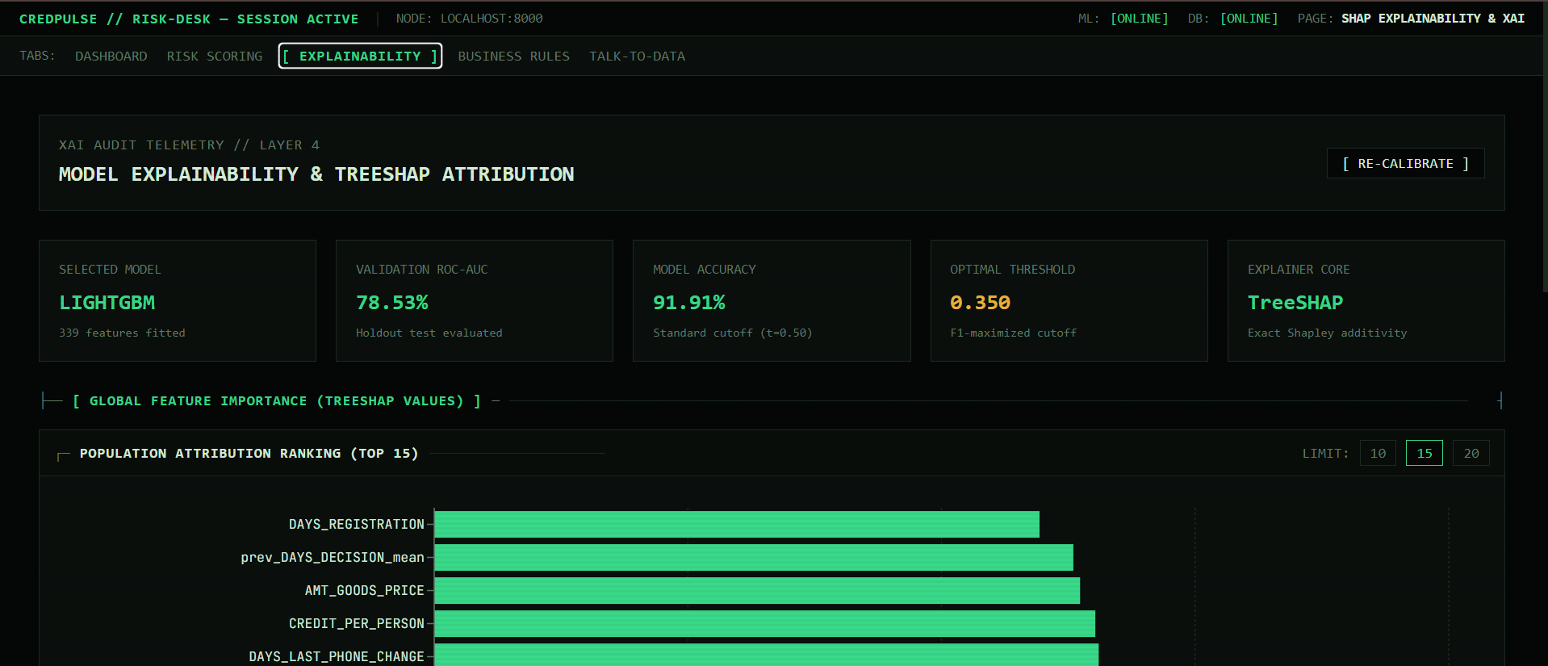
MODULE 4
Explainable AI — TreeSHAP
Every prediction is explained with exact Shapley values computed on the same processed feature vector used for scoring — not a generic summary. Each risk factor is shown with its direction of effect (increases or reduces risk) in plain English, suitable for a non-technical underwriter.
Local, per-applicant attribution
Explains this specific decision, not a generic model summary.
Additive & reproducible
base_value + Σ shap values reconstructs the model's raw output exactly, every run.
Adverse-action ready
Risk-increasing and risk-reducing factors surfaced separately for compliance.
CredPulse — AI-Powered Credit Risk Intelligence Platform
8

Slide 9
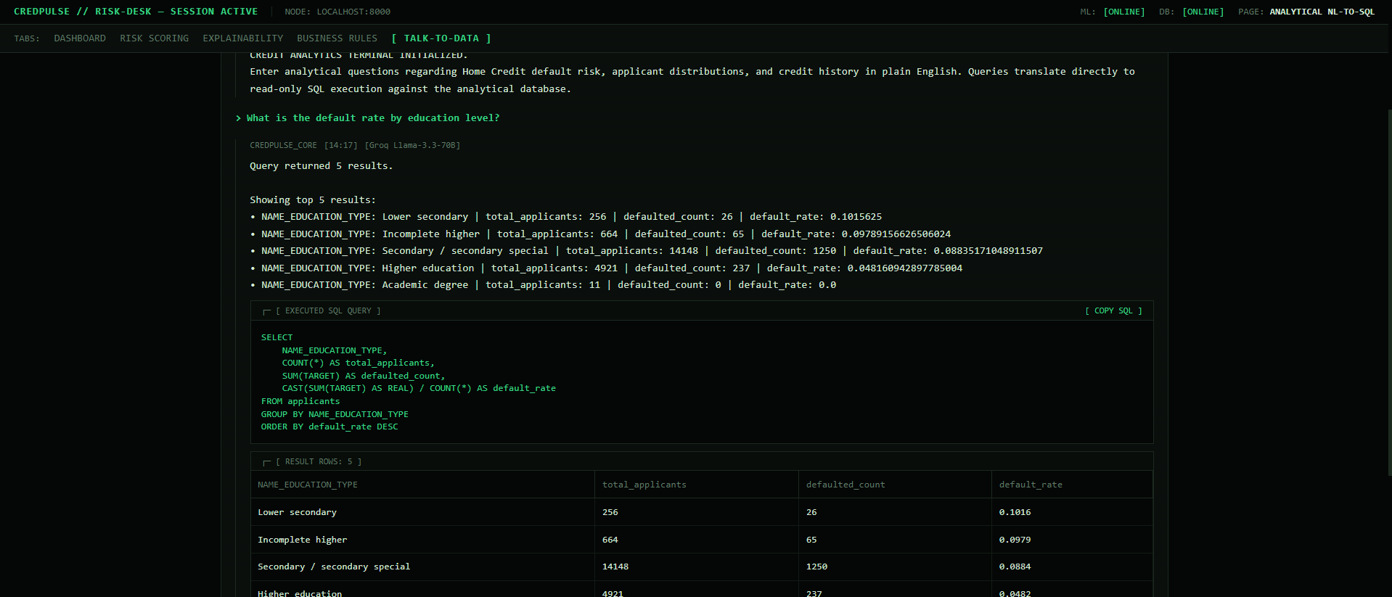
MODULE 2
Talk-to-Data — Natural Language to SQL
From Question to Verified Answer
Schema-only prompting
Groq Llama-3.3-70B sees table/column schemas only — never real values — eliminating fabricated figures.
SQL safety firewall
Blocks DROP, DELETE, UPDATE, INSERT, ALTER, ATTACH and enforces row LIMITs before execution.
Deterministic offline fallback
25+ hard-coded query templates answer common questions with zero API key or internet dependency.
Every answer is a real query result
Figures come from SQL executed against 307K+ actual records — not model-generated text.
CredPulse — AI-Powered Credit Risk Intelligence Platform
9

Slide 10
MODULE 5
Six Evidence-Based Business Rules
Every rule is derived from empirical EDA correlations and SHAP importance rankings — not arbitrary thresholds.
BR-01
BR-02
BR-03
Low External Credit Score
High Debt Burden
Young + Thin Credit File
Mean EXT_SOURCE < 0.35 → 21.4% default rate vs 3.2% for prime applicants
Credit-to-income ratio > 4.0 flags disproportionate debt load
Age < 25 with EXT_SOURCE < 0.40 → 11.5% default rate
BR-04
BR-05
BR-06
Prior Application Refusals
Late Installment History
Prime Fast-Track Pass
≥2 prior refusals → defaulters average 2.3× more rejections
>20% delayed payments signals liquidity distress
EXT_SOURCE > 0.55 & DTI < 3.0 → <2.0% default, auto-approval eligible
CredPulse — AI-Powered Credit Risk Intelligence Platform
10

Slide 11
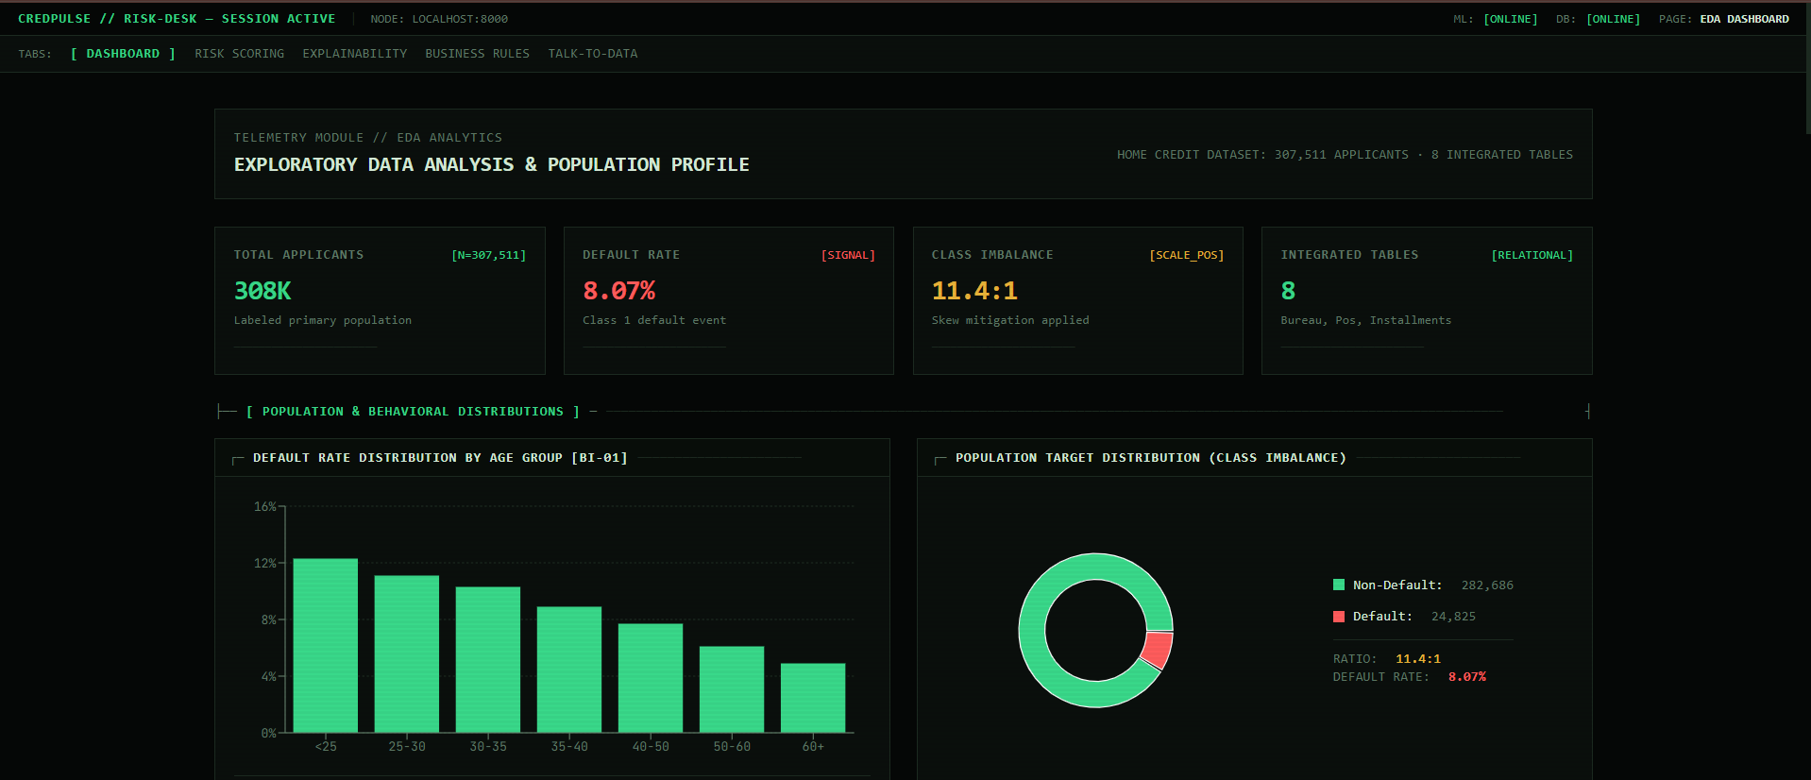
MODULE 5 — USER INTERFACE
Live Application — Dashboard
Multi-section UI: EDA overview with dataset stats and key charts.
CredPulse — AI-Powered Credit Risk Intelligence Platform
11

Slide 12
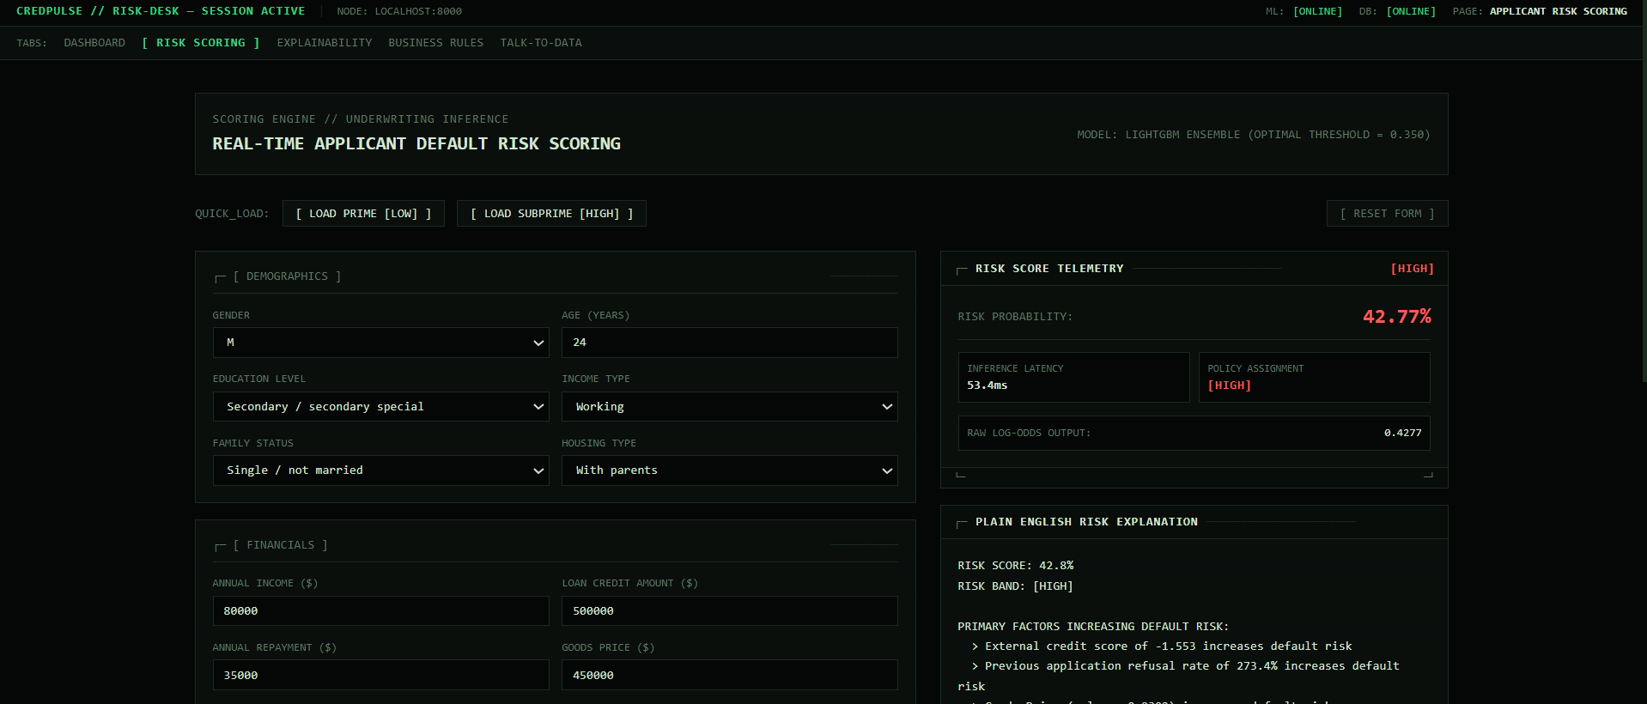
MODULE 5 — USER INTERFACE
Live Application — Risk Prediction
Applicant intake form with calibrated risk score, band, and SHAP explanation.
CredPulse — AI-Powered Credit Risk Intelligence Platform
12

Slide 13
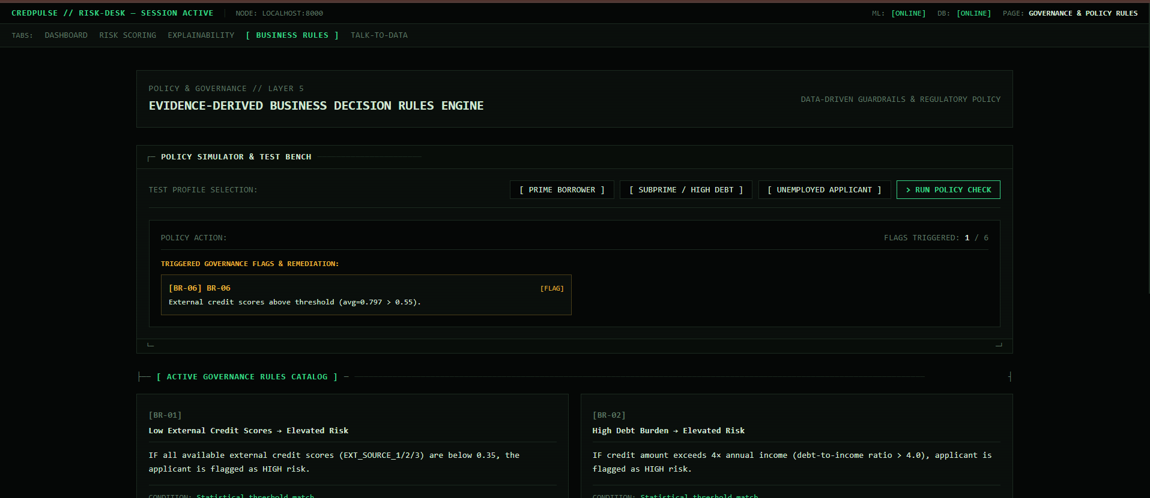
MODULE 5 — USER INTERFACE
Live Application — Business Rules Panel
Rule engine simulator showing which of the 6 guardrails an applicant triggers.
CredPulse — AI-Powered Credit Risk Intelligence Platform
13

Slide 14

MODULE 6
Dockerized, Single-Command Deployment
A multi-stage Dockerfile builds the React frontend and Python backend into a single image. A startup entrypoint script automatically prepares the analytical database — from a bundled seed database, mounted Kaggle CSVs, or a graceful offline notice — so the evaluator never has to run a manual step.
Dockerfile
docker-compose.yml
Multi-stage build: Node build stage for the React frontend, Python 3.11 slim runtime for FastAPI + LightGBM + SHAP.
Single-service orchestration, port mapping, health check, and volume mounts for data/models/reports.
docker-entrypoint.sh
.env.example
Auto-detects and activates the analytical database: seed DB → mounted CSVs → offline notice, in that order.
Documents every required variable — Groq API key, port, database path — so no configuration is guessed.
docker-compose up → full platform running on http://localhost:8000

Slide 15

ENGINEERING NOTES
Known Limitations & Next Steps
KNOWN LIMITATIONS
PLANNED IMPROVEMENTS
SHAP explanations run on the pre-calibration base model; direction and ranking of factors remain valid since isotonic calibration is monotonic, but raw magnitudes differ from the displayed calibrated percentage.
Conversation memory in Talk-to-Data so follow-up questions resolve against prior query context.
Feature-name/pipeline-output alignment is now protected by a hard startup assertion, added after an earlier column-drift issue was found during review.
Incorporate POS_CASH_balance and credit_card_balance tables for a fuller behavioral feature set.
CORS is currently permissive (wildcard origin) since the entire application — frontend and backend — is deployed as a single service on Render; would be scoped to specific origins if the frontend were split into a separately hosted deployment.
Move from SQLite to PostgreSQL if the platform moves beyond a single-user demo deployment.
CredPulse — AI-Powered Credit Risk Intelligence Platform
15

Slide 16


Thank You
CredPulse — AI-Powered Credit Risk Intelligence Platform
github.com/Abhishek84094/AI-Powered-Credit-Risk-Intelligence-Platform
Live: ai-powered-credit-risk-intelligence.onrender.com
Submitted for the NeoStats AI Engineer Role

